Slide 1
Final Capstone Project Presentation
Clustering the neighborhoods in Frankfurt

Slide 2
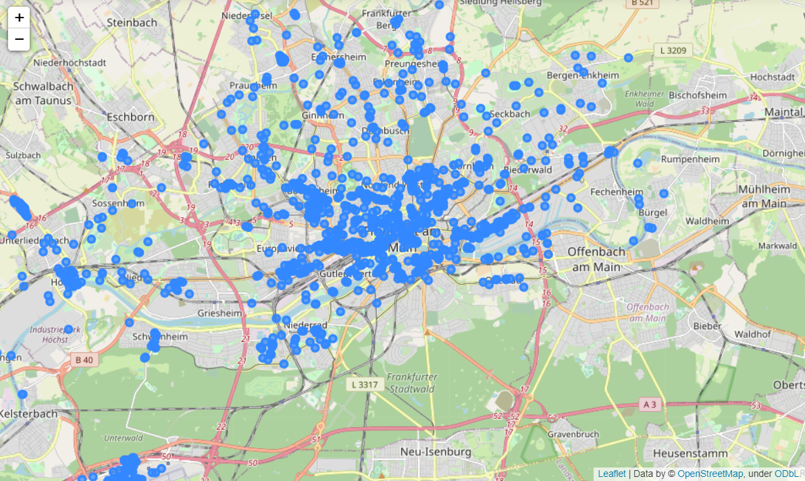
Using location data from Foursquare
Data:
1198 individual locations
239 different categories
38 neighborhoods
Problem:
Use the venue data to categorize a neighborhood, with the purpose of determining suitable for searching for an apartment.

Slide 3
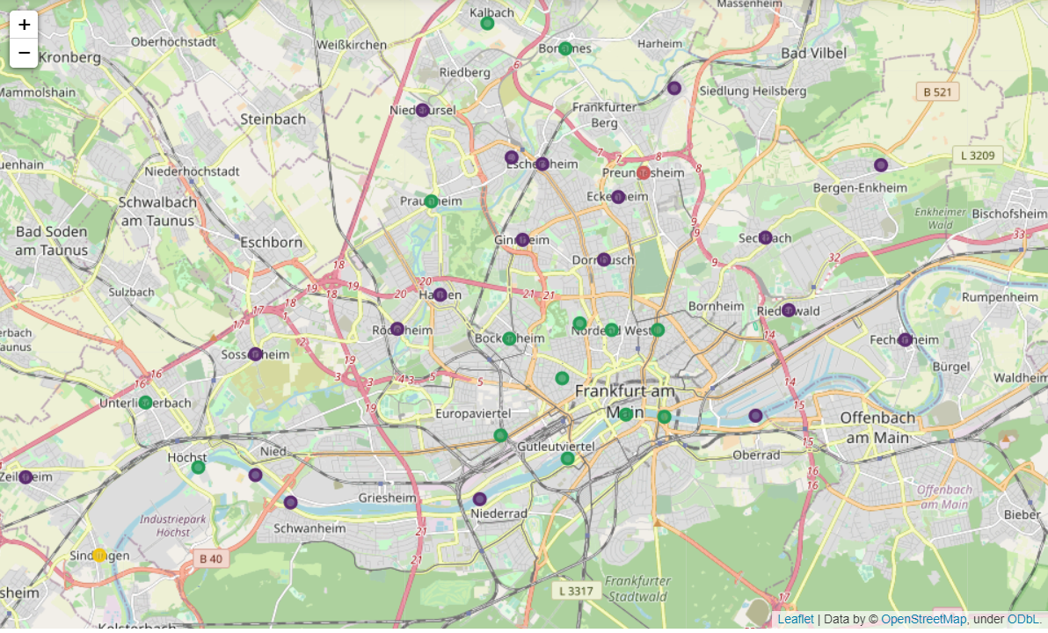
K-means clustering
Using the K-means algorithm, I have clustered the neighborhood using the venue categories.
Green clusters: the presence of Cafés, Ethnical restaurants and clubs suggest that this type of neighborhood is more suitable for a student.
Purple clusters: the presence of Hotels, German restaurants and public transportation suggests that this type of neighborhoods is more suitable for a worker or a family.
Others: these neighborhoods have unique characteristics.

